Slide 1
Application: Multi-Layer Perceptron (MLP)
Structure and Function
Activation Functions
Applications

Slide 2
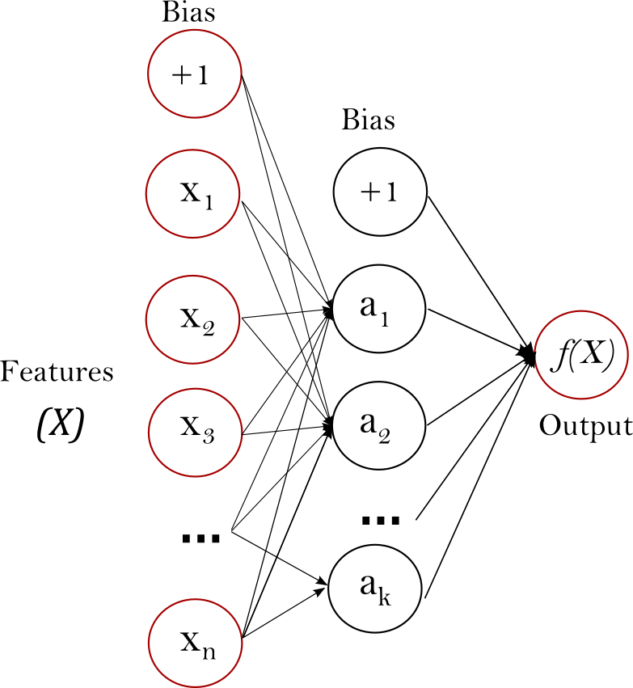
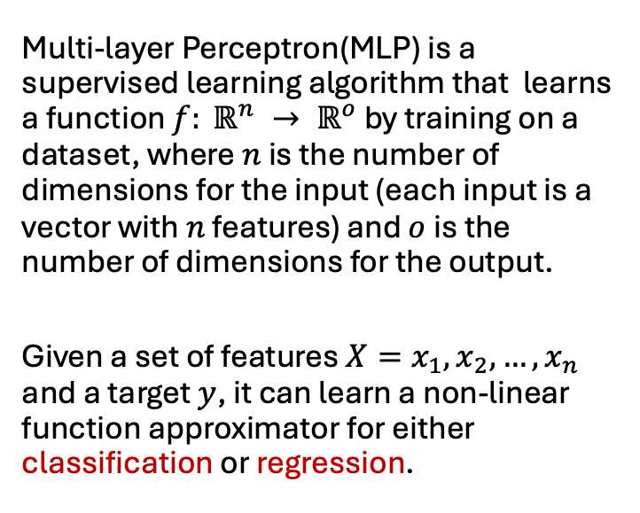
Structure and Function
Multi-layer Perceptron(MLP) is a supervised learning algorithm that learns a function $f: ℝ^{n} → ℝ^{o}$ by training on a dataset, where $n$ is the number of dimensions for the input (each input is a vector with $n$ features) and $o$ is the number of dimensions for the output.
Given a set of features $X=x_{1}, x_{2}, …,x_{n}$ and a target $y$, it can learn a non-linear function approximator for either classification or regression.

Slide 3
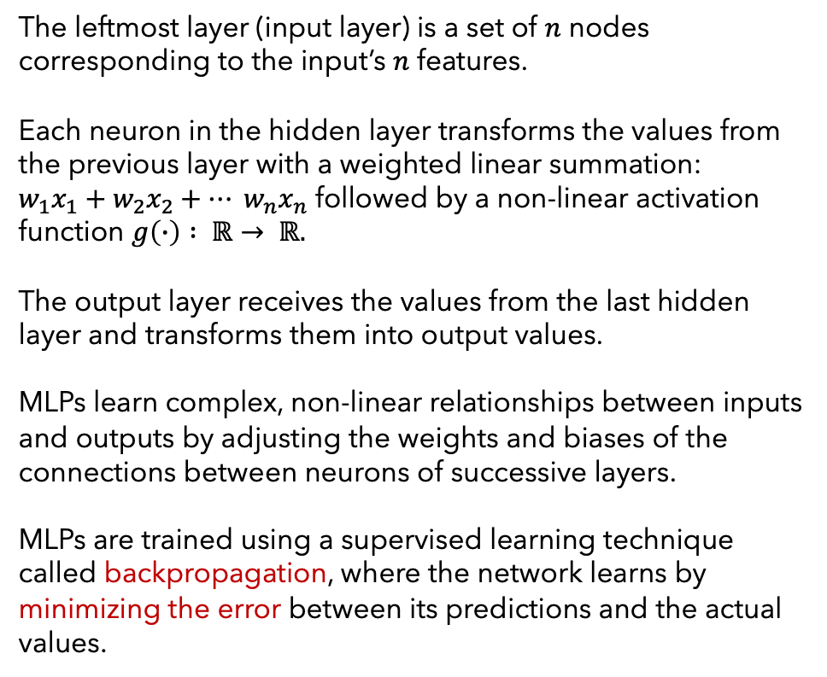
The leftmost layer (input layer) is a set of $n$ nodes corresponding to the input’s $n$ features.
Each neuron in the hidden layer transforms the values from the previous layer with a weighted linear summation:
$w_{1}x_{1}+w_{2}x_{2}+… w_{n}x_{n}$ followed by a non-linear activation function $g\left(∙\right) : ℝ→ ℝ.$
The output layer receives the values from the last hidden layer and transforms them into output values.
MLPs learn complex, non-linear relationships between inputs and outputs by adjusting the weights and biases of the connections between neurons of successive layers.
MLPs are trained using a supervised learning technique called backpropagation, where the network learns by minimizing the error between its predictions and the actual values.

Slide 4
Applications include:
Classification: Categorizing data into different classes.
Regression: Predicting continuous values.
Image Recognition: Identifying objects in images.
Speech Recognition: Converting spoken language into text.
Natural Language Processing: Understanding and generating human language.
Time Series Forecasting: Predicting future values based on past data.
Advantages:
Can handle both classification and regression.
Capable of learning complex, non-linear relationships.
Can be adapted to various types of data with appropriate preprocessing.
Automatically learn relevant features from raw data, reducing the need for manual feature engineering.
Disadvantages:
MLP requires tuning a number of hyperparameters such as the number of hidden layers, neurons, iterations.
MLP is sensitive to feature scaling.

Slide 5
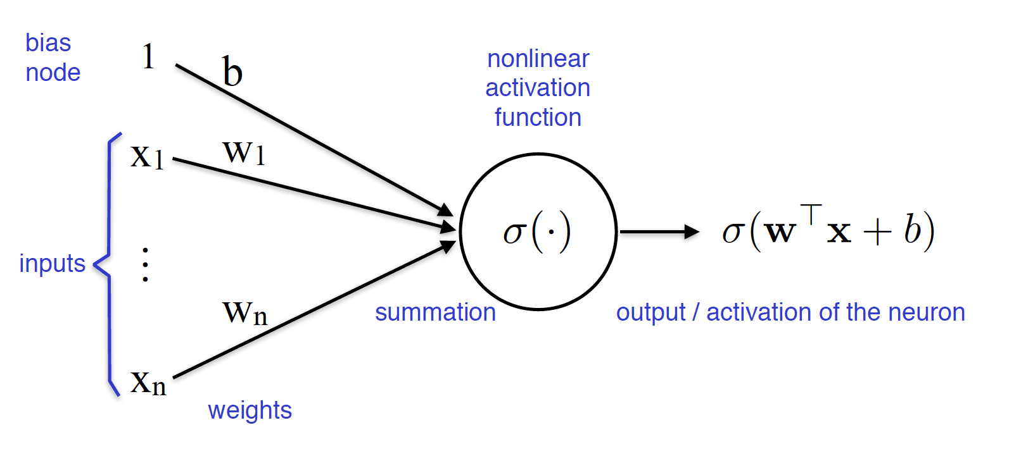
Activation Functions in MLPs
Activation functions determine how the weighted sum of the input of a neuron in a layer is transformed into an output for that neuron.
Activation functions are nonlinear and are differentiable at almost all their inputs.
In the hidden layer(s) of MLPs the activation functions mostly commonly used are: ReLu, Sigmoid, Hyperbolic Tangent.
A NN almost always uses the same activation function in all it hidden layers.
ReLu is widely used because of its simplicity.
Perceptron in hidden or output layer

Slide 6
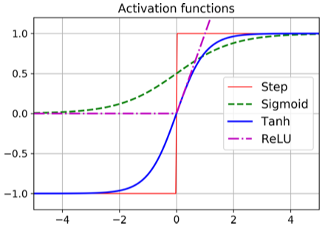
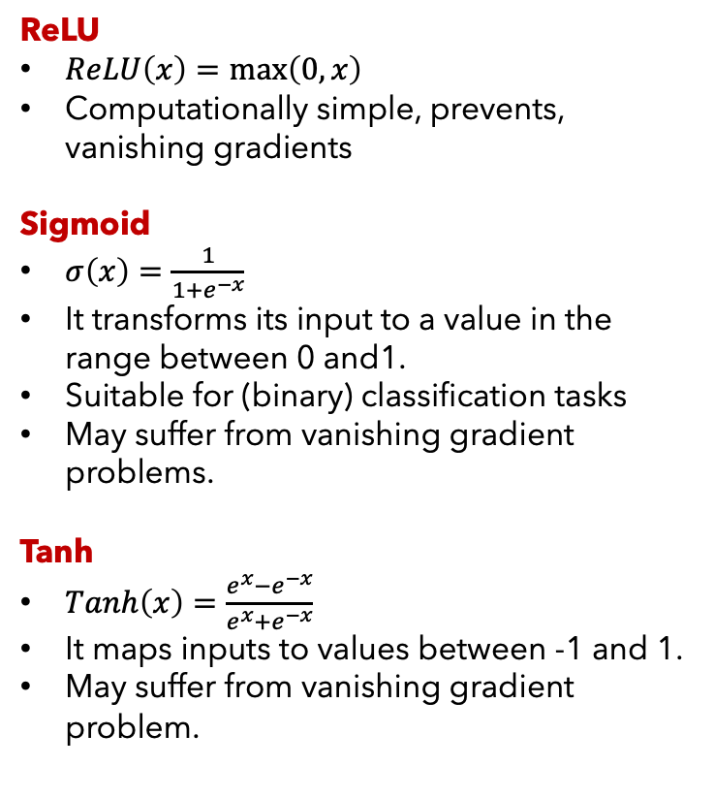
Hidden Layer Perceptron
For the hidden layers in NN, common activation functions are ReLU (Rectified Linear Unit), Sigmoid (logistic function), and Tanh (Hyperbolic Tangent function), with ReLU being the most prevalent due to its computational simplicity.
ReLU
$ReLU\left(x\right)=\max\left(0, x\right)$
Computationally simple, prevents, vanishing gradients
Sigmoid
$σ\left(x\right)=\frac{1}{1+e^{−x}}$
It transforms its input to a value in the range between 0 and1.
Suitable for (binary) classification tasks
May suffer from vanishing gradient problems.
Tanh
$Tanh\left(x\right)=\frac{e^{x}−e^{−x}}{e^{x}+e^{−x}}$
It maps inputs to values between -1 and 1.
May suffer from vanishing gradient problem.

Slide 7
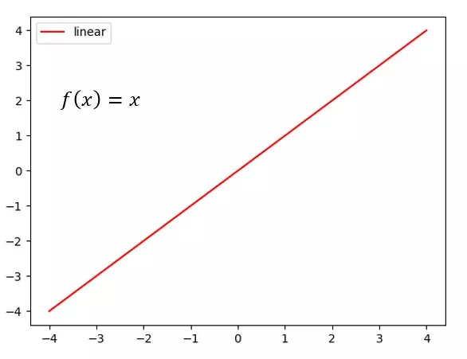
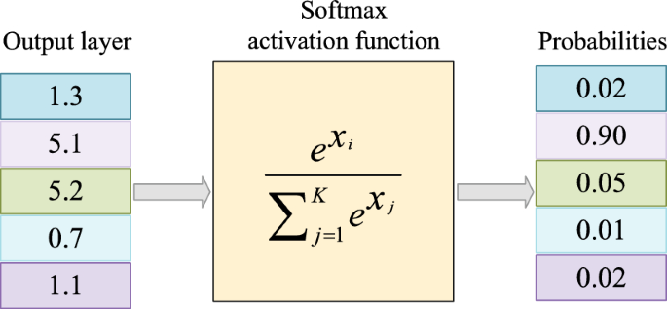
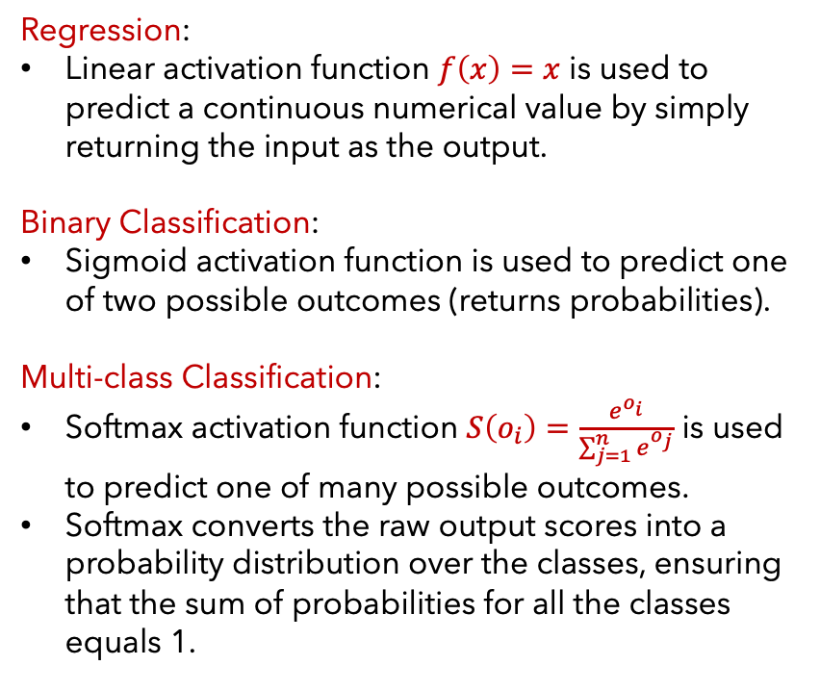
Output Layer Perceptron
For the output layer of a NN, typical activation functions are Linear, Sigmoid, or Softmax functions, depending on whether the task at hand is linear regression, binary classification, or multi-class classification.
Regression:
Linear activation function $f\left(x\right)=x$ is used to predict a continuous numerical value by simply returning the input as the output.
Binary Classification:
Sigmoid activation function is used to predict one of two possible outcomes (returns probabilities).
Multi-class Classification:
Softmax activation function $S\left(o_{i}\right)=\frac{e^{o_{i}}}{\sum_{j=1}^{n}{e^{o_{j}}}}$ is used to predict one of many possible outcomes.
Softmax converts the raw output scores into a probability distribution over the classes, ensuring that the sum of probabilities for all the classes equals 1.

Slide 8
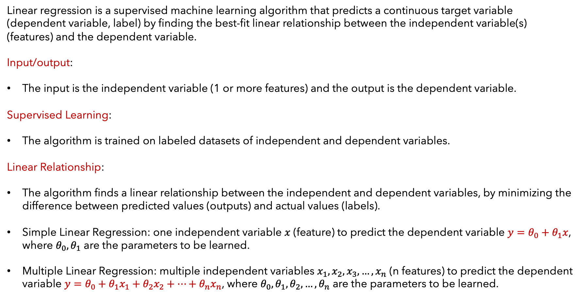
Application: Linear Regression
Linear regression is a supervised machine learning algorithm that predicts a continuous target variable (dependent variable, label) by finding the best-fit linear relationship between the independent variable(s) (features) and the dependent variable.
Input/output:
The input is the independent variable (1 or more features) and the output is the dependent variable.
Supervised Learning:
The algorithm is trained on labeled datasets of independent and dependent variables.
Linear Relationship:
The algorithm finds a linear relationship between the independent and dependent variables, by minimizing the difference between predicted values (outputs) and actual values (labels).
Simple Linear Regression: one independent variable $x$ (feature) to predict the dependent variable $y=θ_{0}+θ_{1}x$, where $θ_{0}, θ_{1}$ are the parameters to be learned.
Multiple Linear Regression: multiple independent variables $x_{1},x_{2},x_{3},…,x_{n}$ (n features) to predict the dependent variable $y=θ_{0}+θ_{1}x_{1}+θ_{2}x_{2}+…+θ_{n}x_{n}$, where $θ_{0}, θ_{1}, θ_{2}, …, θ_{n}$ are the parameters to be learned.

Slide 9
Assumptions:
Relationship between independent and dependent variables should be linear.
Observations in the dataset should be independent of each other
The variance of errors should be constant across all levels of the independent variable(s). (Homoscedasticity)
The residuals (errors) should be normally distributed.
Applications:
Predict house prices using features like size, location, number of bedrooms, age.
Forecast sales based on factors like advertising spending and seasonality.
Predict stock prices based on historical data and economic indicators.
Model relationships between variables in experiments.
Evaluation Metrics:
MSE
MAE
R-squared.

Slide 10
Application: Logistic Regression
Logistic regression is a supervised machine learning algorithm used for binary classification, predicting the probability of an event occurring (Yes or No, 0/1) based on input features, by using the sigmoid function to map a linear combination of features to a probability value between 0 and 1.
Input/output:
The input is the independent variable (1 or more features) and the output has two possible values or classes (e.g. Yes/No, True/False, Positive/Negative etc.)
The Sigmoid function takes a linear combination of input features and transforms it into a probability value between 0 and 1.
Instead of predicting a specific class directly, logistic regression predicts the probability of an instance belonging to a specific class.
Multinomial logistic regression (outcome has more than 2 categories) the Softmax function is used in place of the Sigmoid.
Applications:
Spam detection
Disease diagnosis
Credit risk assessment
Sentiment analysis

Slide 11
Advantages:
Easy to implement and interpret.
Relatively computationally efficient.
Provides probabilities, not just class labels.
Disadvantages:
Can struggle with non-linear relationships.
May require a large dataset
Assumes independence between features.
Evaluation Metrics:
Accuracy
Precision

Slide 12
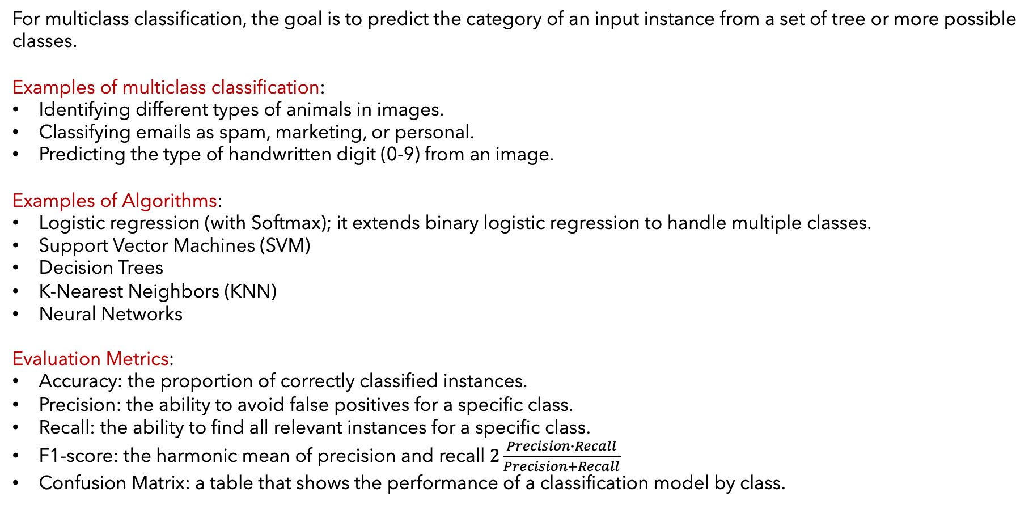
Application: Multiclass Classification
For multiclass classification, the goal is to predict the category of an input instance from a set of tree or more possible classes.
Examples of multiclass classification:
Identifying different types of animals in images.
Classifying emails as spam, marketing, or personal.
Predicting the type of handwritten digit (0-9) from an image.
Examples of Algorithms:
Logistic regression (with Softmax); it extends binary logistic regression to handle multiple classes.
Support Vector Machines (SVM)
Decision Trees
K-Nearest Neighbors (KNN)
Neural Networks
Evaluation Metrics:
Accuracy: the proportion of correctly classified instances.
Precision: the ability to avoid false positives for a specific class.
Recall: the ability to find all relevant instances for a specific class.
F1-score: the harmonic mean of precision and recall $2\frac{Precision∙Recall}{Precision+Recall}$
Confusion Matrix: a table that shows the performance of a classification model by class.

Slide 13
Dealing with Imbalanced Datasets:
Under-sampling: reduce the number of samples in the majority classes.
Over-sampling: increase the number of samples in the minority classes.
Synthetic Data Generation: Create synthetic samples for the minority classes.
Loss functions for multi-class classification:
Categorical Cross-Entropy Loss (Log Loss): it quantifies the difference between the predicted probability distribution and the actual (true) class labels (in one-hot encoded vectors).
Sparce Categorical Cross-Entropy Loss: a variation of categorical cross-entropy, specifically designed for scenarios where the true labels are provided as integers (e.g., 0, 1, 2) instead of one-hot encoded vectors.
It is particularly useful when dealing with large datasets and a large number of classes.

Slide 14
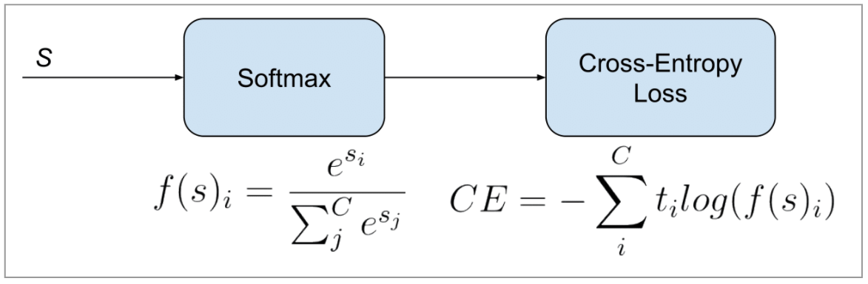
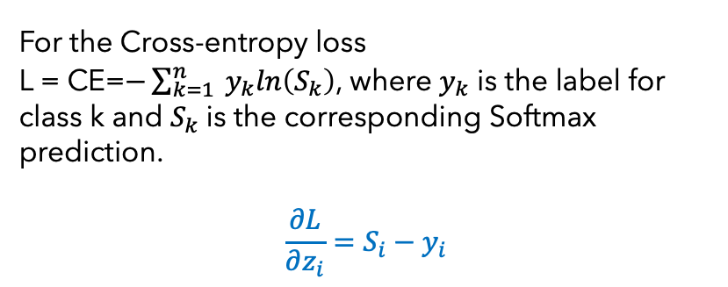
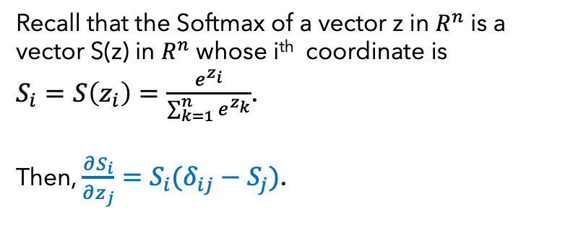
More of the Softmax Function
The Softmax activation function transforms the output of a neural network into a probability distribution over the classes, ensuring that the probabilities for all classes sum up to 1.
Recall that the Softmax of a vector z in $R^{n}$ is a vector S(z) in $R^{n}$ whose i^{th} coordinate is
$S_{i}=S\left(z_{i}\right)=\frac{e^{z_{i}}}{\sum_{k=1}^{n}{e^{z_{k}}}}$.
Then, $\frac{∂S_{i}}{∂z_{j}}=S_{i}(δ_{ij}−S_{j})$.
For the Cross-entropy loss
L = CE=$−\sum_{k=1}^{n}{ y_{k}ln\left(S_{k}\right)}$, where $y_{k}$ is the label for class k and $S_{k}$is the corresponding Softmax prediction.
$$\frac{∂L}{∂z_{i}}=S_{i}−y_{i}$$
Cross-entropy loss as a function of the Softmax values

Slide 15
Example of Classification on the MNIST Data Set
# fetch the data with tensorflow
mnist = tf.keras.datasets.mnist
#download the images (28x28 handwritten digits
(x_train, y_train), (x_test, y_test) = mnist.load_data()
#normalize data
x_train, x_test = x_train / 255.0, x_test / 255.0
#define the model
model = tf.keras.models.Sequential([
tf.keras.layers.Flatten(input_shape=(28, 28)),
tf.keras.layers.Dense(16, activation=‘relu’),
tf.keras.layers.Dense(16, activation=‘relu’),
tf.keras.layers.Dense(10, activation=‘softmax’) ])
#compile the model
model.compile(optimizer=‘sgd’, loss=‘categorical_Crossentropy’, metrics=[‘accuracy’] )
model.summary
#run the model
model.fit(x_train, y_train, epoch=3, batch_size=10)

Slide 16
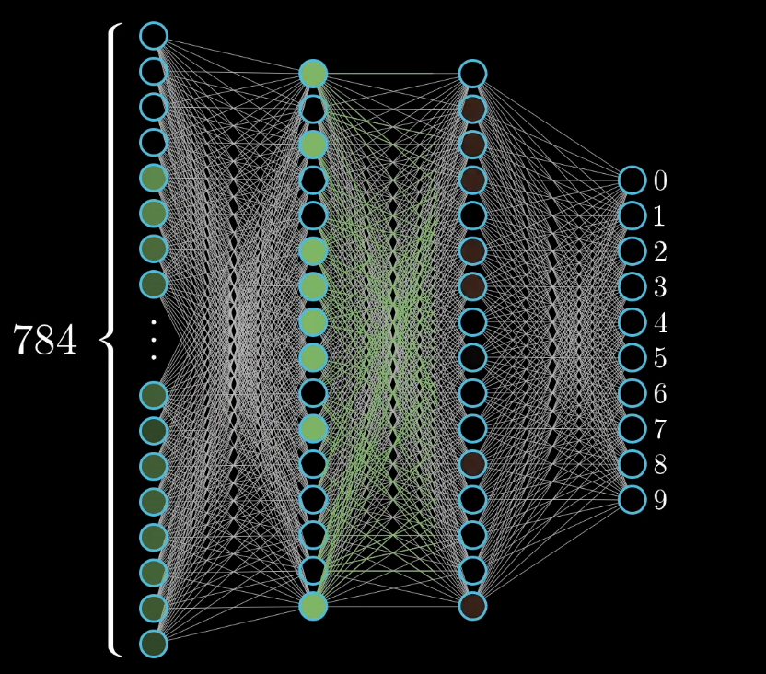
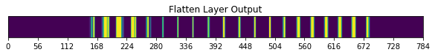
(Mnist) multi-layer perceptron network

Slide 17
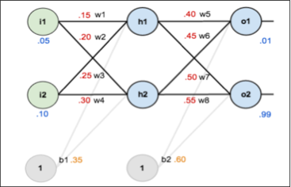
Numerical Example
Simple Neural Network with:
1 Input layer (2 features)
1 Hidden layer (2 neurons, activation sigmoid)
1 Output layer (2 nodes for 2 classes, activation sigmoid)
Compute the outputs and the MSE loss
Compute the gradient of the loss function with respect to
The weights and biases
Update the weights and biases using gradient descent.
Compute the now loss function values with the updated
weights and biases.
Compare the loss function values from the first and second
and second pass.

Slide 18
Choosing the Best Optimization Algorithm
Purpose:
Machine learning optimization algorithms are used to iteratively adjust model parameters to minimize a loss function, thus improving the model’s accuracy for the purpose of generalization.
Minimizing the Error:
The primary goal of training a ML model is to minimize the difference between predicted and actual outputs (often measured by a loss function).
Parameter Adjustment:
Optimization algorithms iteratively adjust the model’s weights and biases to find the (optimal) values that lead to the lowest loss.
Improved Generalization:
With optimal values of its parameters, the model becomes better at making accurate predictions on unseen data, a crucial aspect of real-world applications.

Slide 19
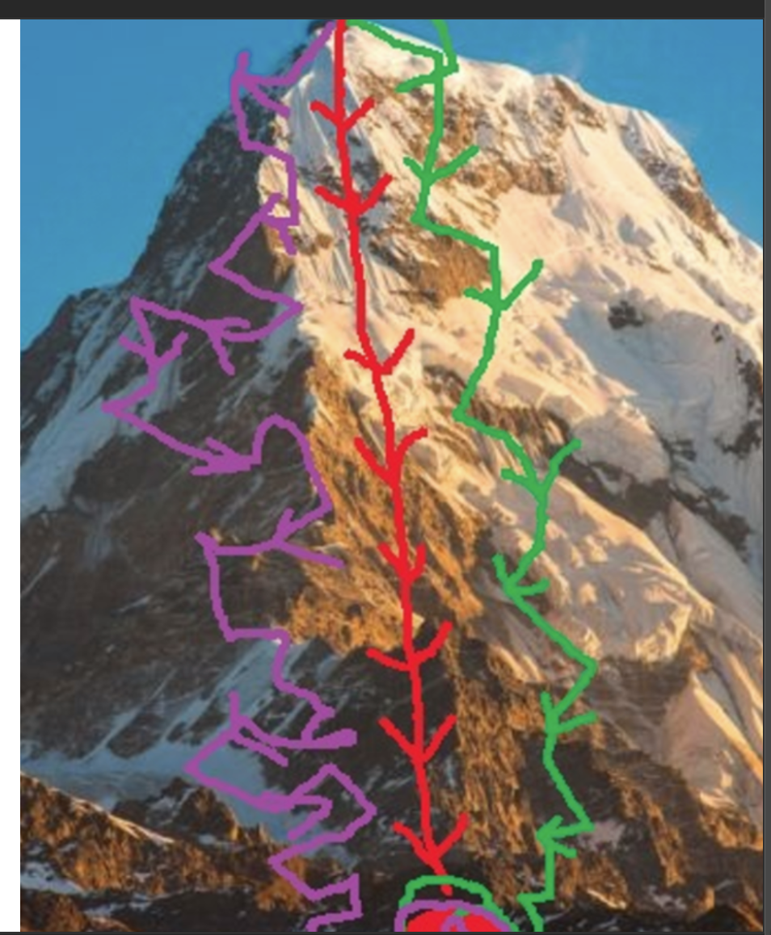
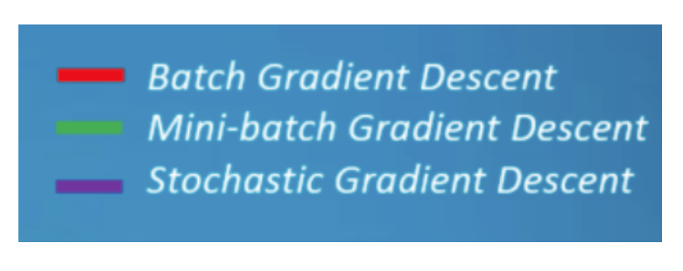
Common Optimization Algorithms
Choosing the right optimizer is essential because different optimizers are better suited to different problems.
Common algorithms include Batch Gradient Descent (BGD), Stochastic Gradient Descent (SGD), Adam, and RMSProp (Adam and others).
Batch gradient descent: iteratively update model parameters by averaging the gradients calculated from the entire training dataset in each iteration.
Stochastic Gradient Descent: uses a single point or a small batch of data points to calculate the gradient in each iteration, leading to faster but potentially noisier convergence.
Mini-Batch Gradient Descent: a compromise between BGD and SGD, using a small batch of data points to calculate the gradient in each iteration, offering a balance between computational efficiency and convergence stability.
Adam: algorithm that adapts the learning rate for each parameter based on gradients mean and variance.

Slide 20
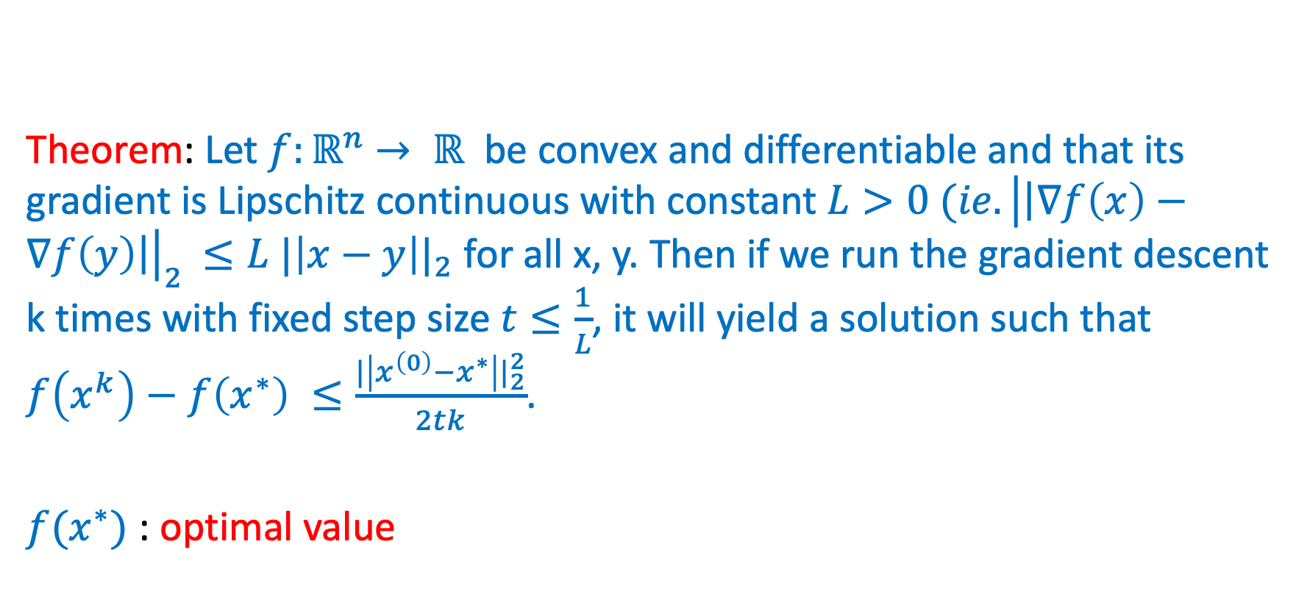
Does the Gradient Descent Method always Converge?
Theorem: Let $f:ℝ^{n}$ $→ ℝ$ be convex and differentiable and that its gradient is Lipschitz continuous with constant $L>0 (ie. {\left|\left|∇f\left(x\right)−∇f\left(y\right)\right|\right|}_{2 }≤L {|\left|x−y\right||}_{2}$ for all x, y. Then if we run the gradient descent k times with fixed step size $t≤\frac{1}{L}$, it will yield a solution such that $f\left(x^{k}\right)−f\left(x^{∗}\right) ≤\frac{{|\left|x^{\left(0\right)}−x^{∗}\right||}_{2}^{2}}{2tk}$.
$f(x^{∗})$ : optimal value

Slide 21
Convergence Problems of Neural Networks
Neural Networks don’t work well if the input, output, and initial weight data is not prepared to match the network design and the actual problem being solved.
A common problem is Saturation, where large signals, sometimes driven by large weights, lead to signals that are at the shallow slopes of the activation function. (This reduces the ability to learn better weights)
Another problem is Zero value signals or weights. (they will kill the ability to learn better weights)
The internal link weights should be random and small (avoid zero).
Inputs should be scaled to be small but not zero. Common range is 0.01 to 0.99 (or -1.0 to 1.0) depending on the problem.
Target/label values should be within the range of what the activation function can produce. (values below 0 or above 1 are impossible to reach for the sigmoid function). Setting training targets outside the valid range drives ever larger weights, leading to saturation. A good range for outputs is 0.01 to 0.99

Slide 22
References
Deep learning by Ian Goodfellow, Yoshua Bengio, and Aaron Courville
Hands-On ML with Scikit-Learn, Keras, and TensorFlow (Aurelien Geron)
Machine Learning with Python by Bernd Klein
LAPENNA Workshop (UTK) by Kwai Wong
6S191 MIT Deep Learning Lecture 1 by Alexander Amini

